Slide 1
TOSN Paper Summary
Steven Lai

Slide 2
Not all Wireless Sensor Networks are Created Equal: A Comparative Study on Tunnels
Test the communication performance of WSN in different environments
An operational tunnel
A non-operational tunnel
A vineyard
Purpose:
Study the performance of WSN performance under similar environments
Compare the difference in communication affected by different environments

Slide 3
Challenges
Node deployment
Large number of experiments (over 1000)
Large volume of data (over 200k) to be processed

Slide 4
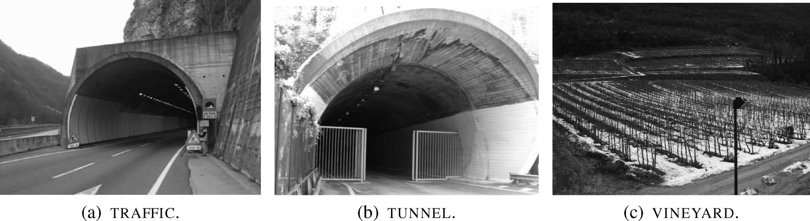
Deployment Environments
Operational tunnel (TRAFFIC)
Non-operational tunnel (TUNNEL)
Vineyard (VINEYARD)

Slide 5
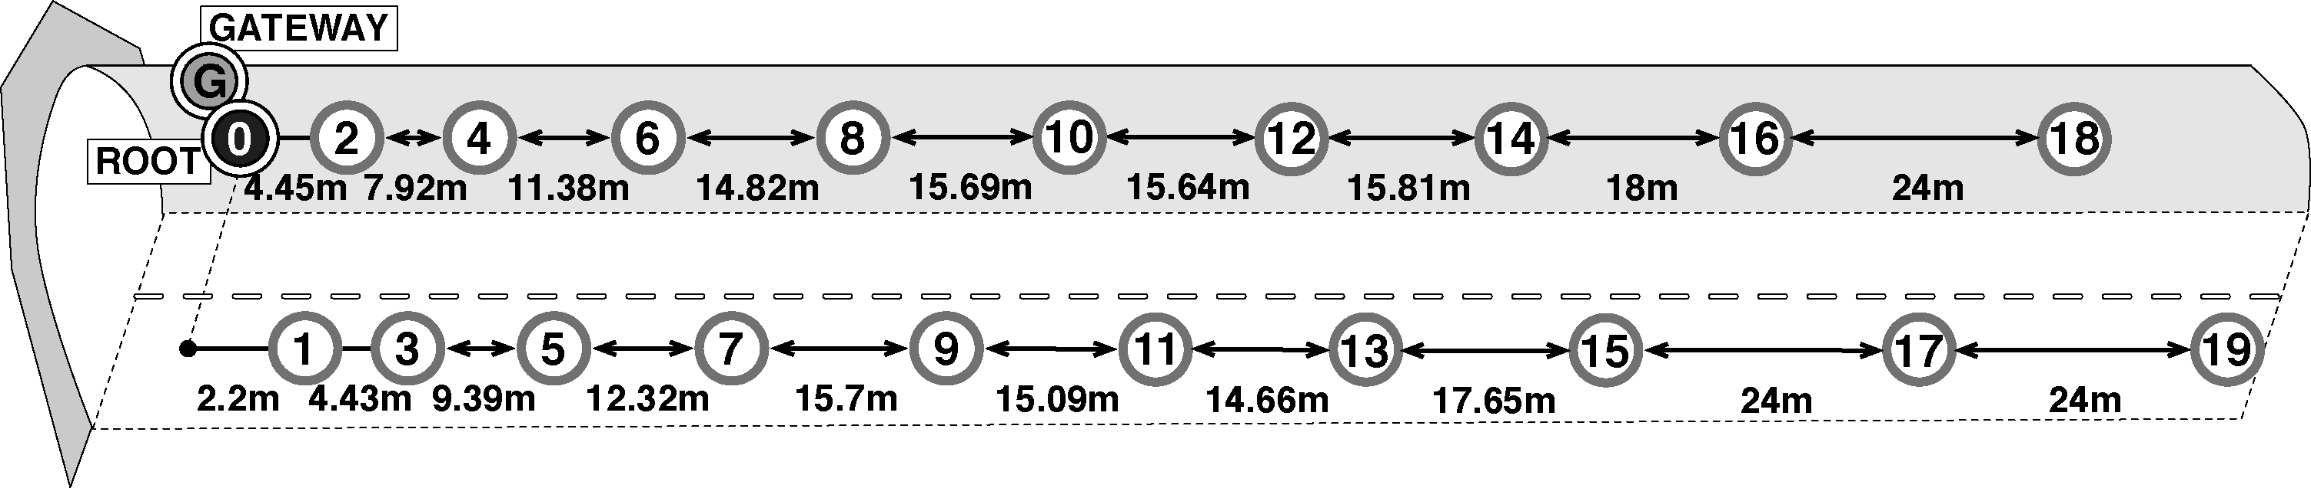
Deployment for TRAFFIC

Slide 6
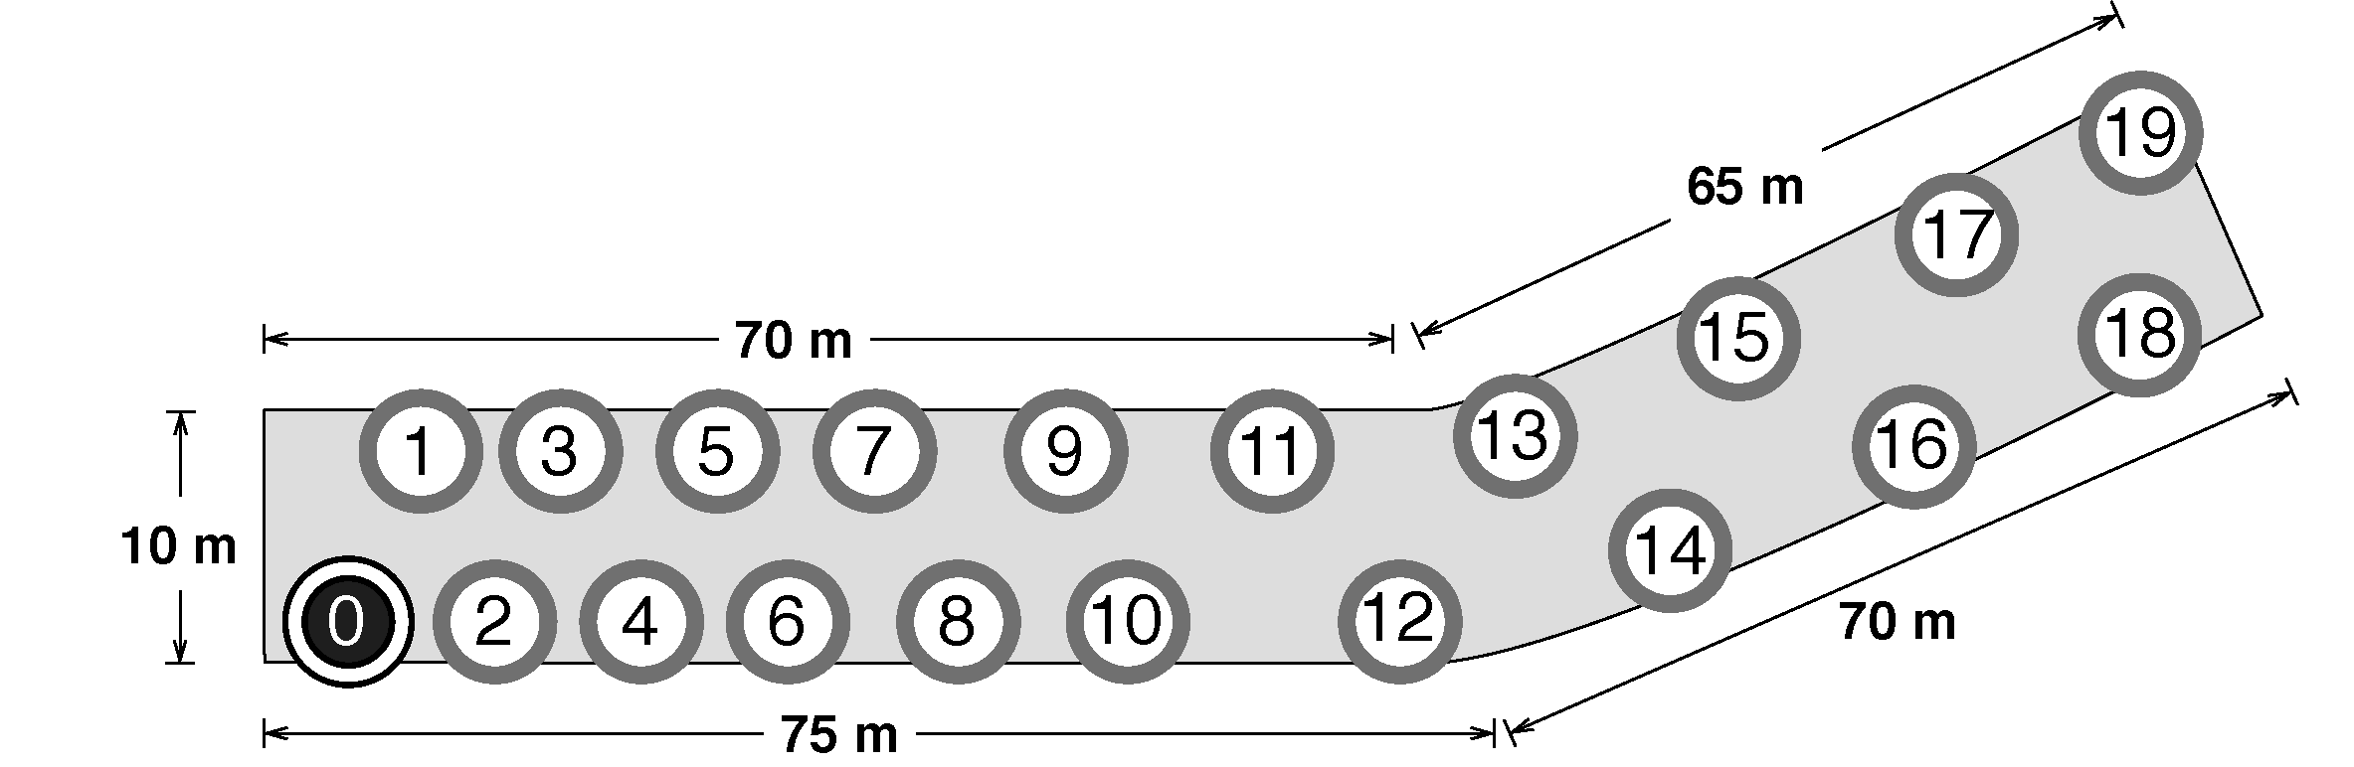
Deployment for Tunnel

Slide 7
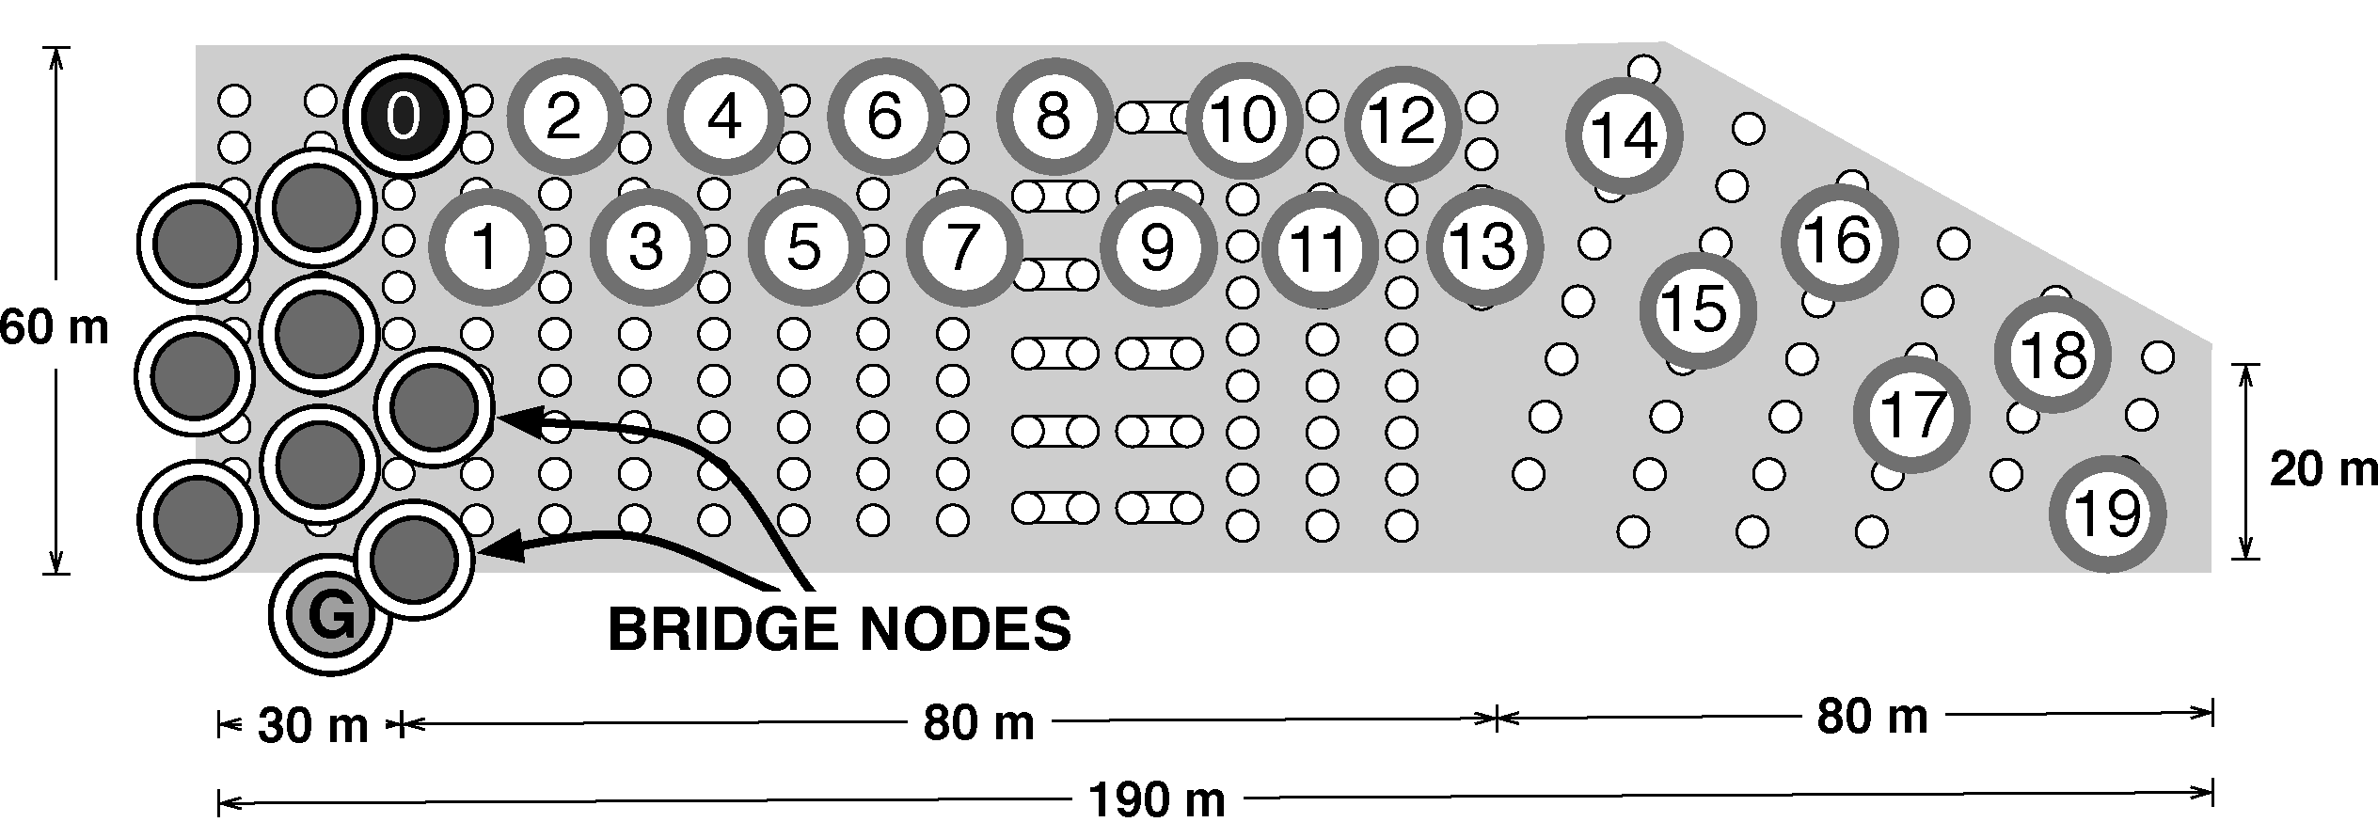
Deployment for VINEYARD

Slide 8
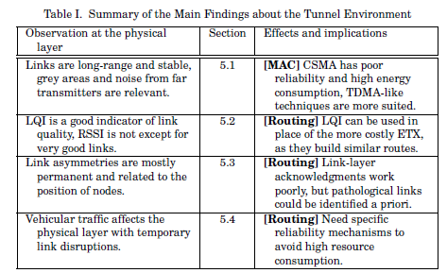
Results

Slide 9
RaPTEX: Rapid Prototyping Tool for Embedded Communication Systems
Purpose of the system:
A toolbox
An analytical performance estimation framework
An emulation environment

Slide 10
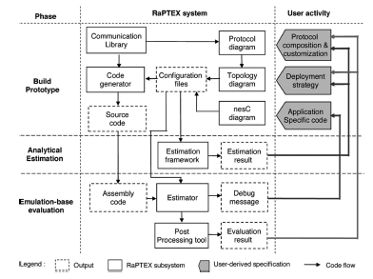
RaPTEX Components

Slide 11
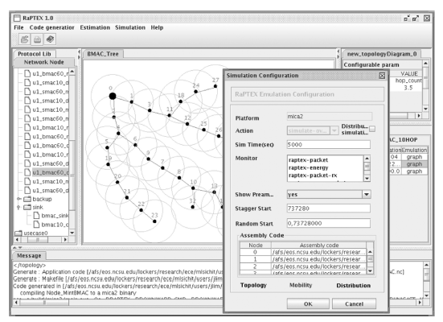
RaPTEX Interface

Slide 12
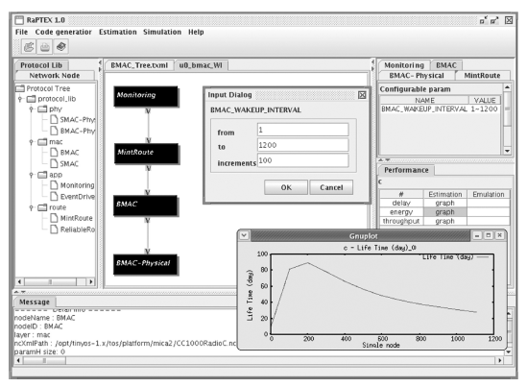
Developing Applications with RaPTEX

Slide 13
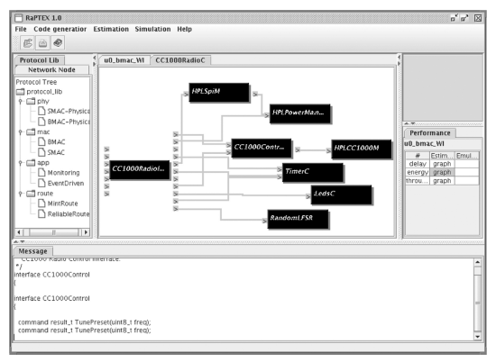
Visualization of the Codes

Slide 14
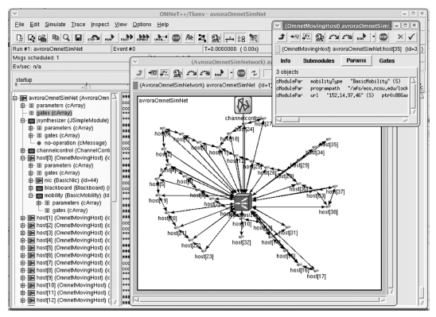
Emulation with RaPTEX

Slide 15
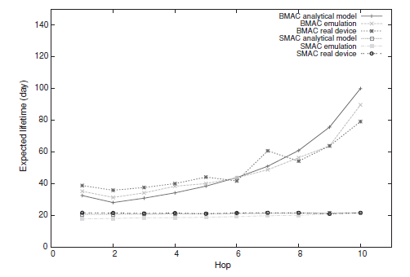
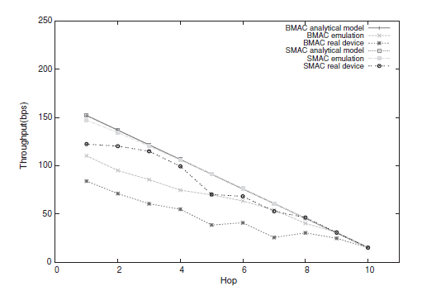
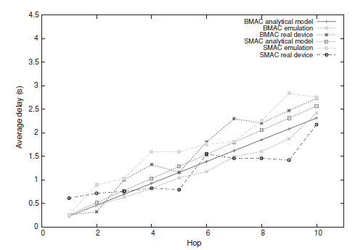
Emulation Accuracy

Slide 16
SensorScope: Application-Specific Sensor Network for Environmental Monitoring
What is SensorScope:
WSN-based application for environment monitoring
Has been deployed for multiple times
The most prominent deployment is on a rock glacier in Switzerland
The paper mainly talks about the software and hardware architecture of SensorScope

Slide 17
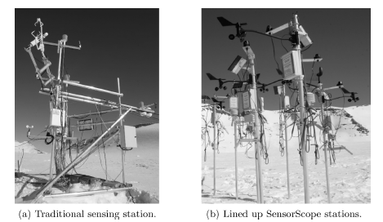
Hardware Platform

Slide 18
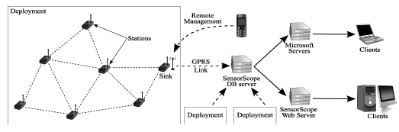
System Architecture

Slide 19
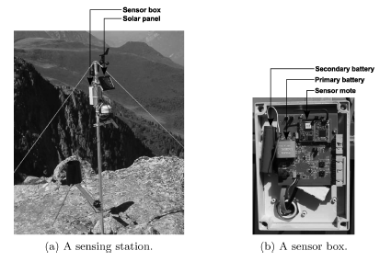
Single Sensor Station Design

Slide 20
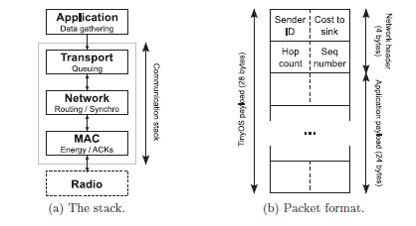
Software Layers

Slide 21
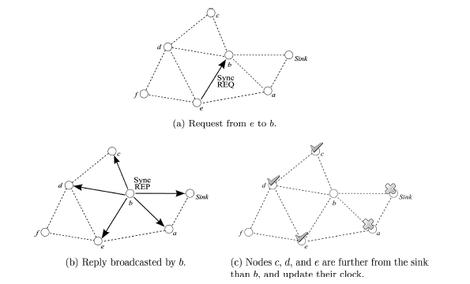
Synchronization Scheme

Slide 22
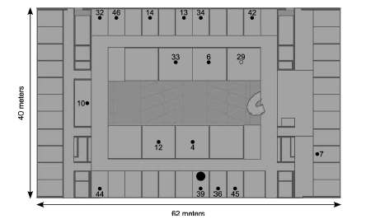
Indoor Experiments

Slide 23
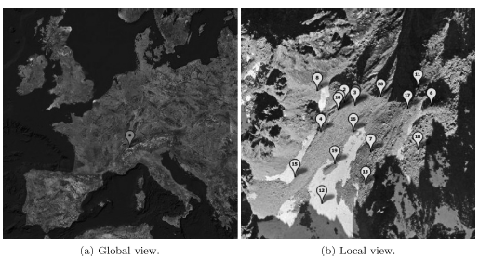
Outdoor Deployment

